Slide 1

Skywalker Airlines
Airline crew scheduler
Increment 2 Retrospective
Team 8
Alexis Saltzman Aniruddha Saxena Dipal Bhandari
Rahul Prajapati Shivani Tamkiya

Slide 2
Overview
Project Description
Use Case Model
Use Case Diagram
Use Cases
Domain Model
Class Diagram
Sequence Diagrams
Reflection

Slide 3
Overview
Project Description
Use Case Model
Use Case Diagram
Use Cases
Domain Model
Class Diagram
Sequence Diagrams
Reflection

Slide 4
Project Overview
This project is based on a crew scheduling system for Cornhusker Airways (CHA ) that performs various tasks for different levels of administrators. It enables CHA to keep track of employees who are scheduled to be on the aircraft. CHA operates two types of aircrafts GBR-10 and NU-150 with capacity of 45 passengers and 75 passengers respectively. There are different authorization protocols for different administrative positions like qualified Captain, first Officer, flight attendant.
Platform - Web and phone application

Slide 5
Overview
Project Description
Use Case Model
Use Case Diagram
Use Cases
Domain Model
Class Diagram
Sequence Diagrams
Reflection

Slide 6
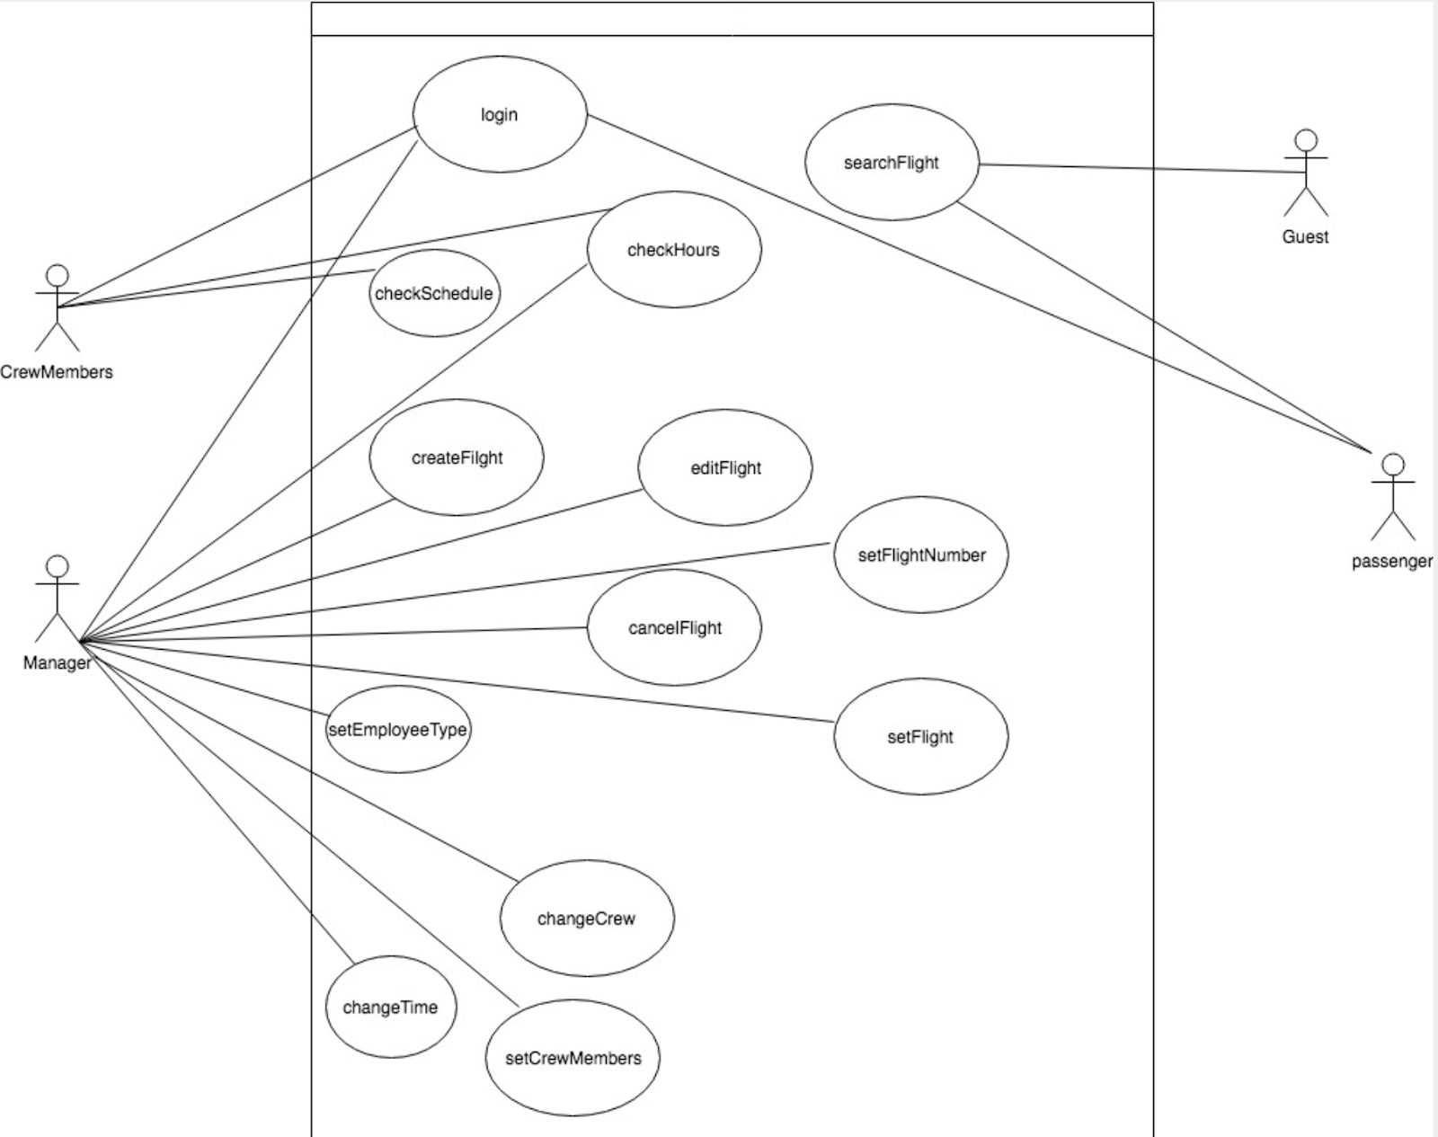
Use Case Diagram

Slide 7
Overview
Domain Project Description
Use Case Model
Use Case Diagram
Use Cases
Model
Class Diagram
Sequence Diagrams
Reflection

Slide 8
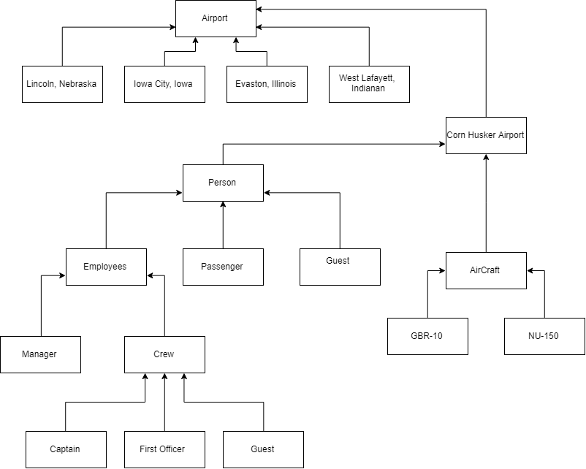
Structural Model
Flight Attendant

Slide 9
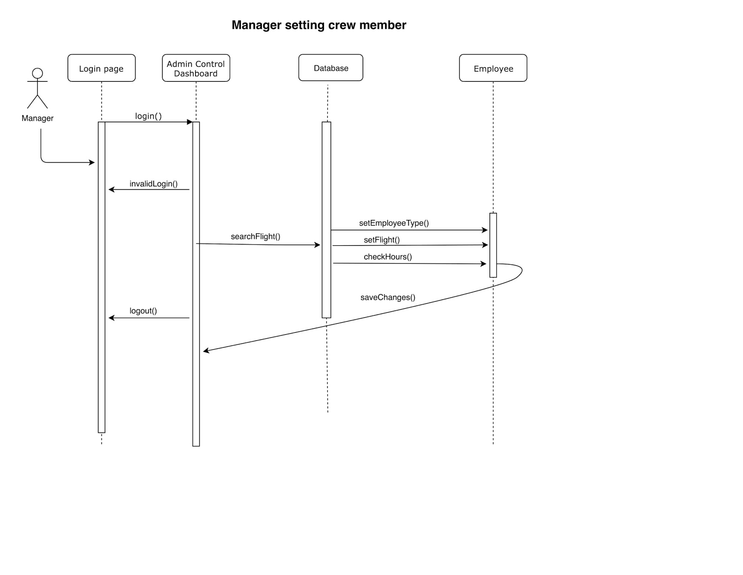
Manager Sequence Diagram (Manager - Luke Skywalker)
Setting Crew Member
Dynamic Model

Slide 10
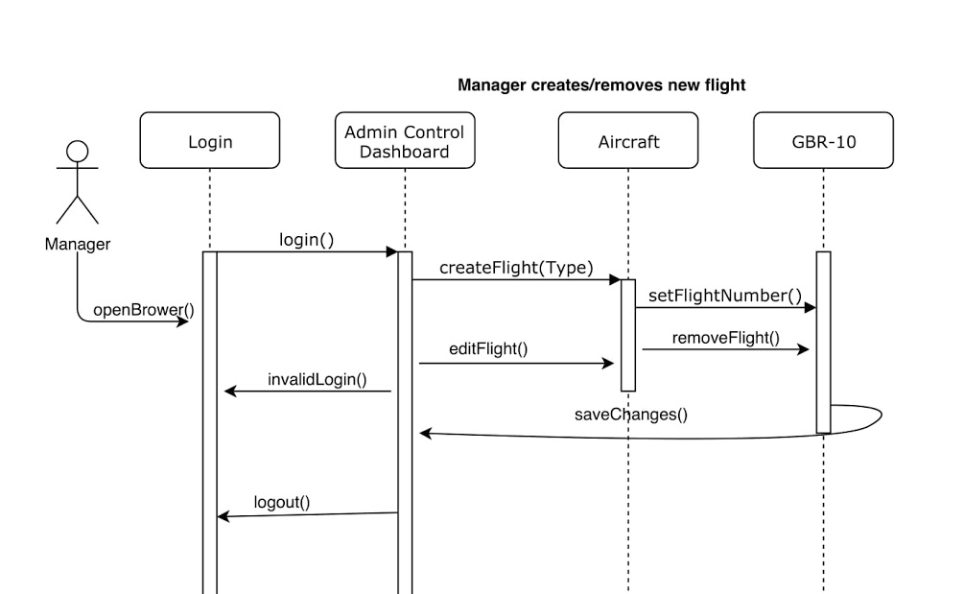
Manager Sequence Diagram (Manager - Luke Skywalker)
Creating flight
Dynamic Model

Slide 11
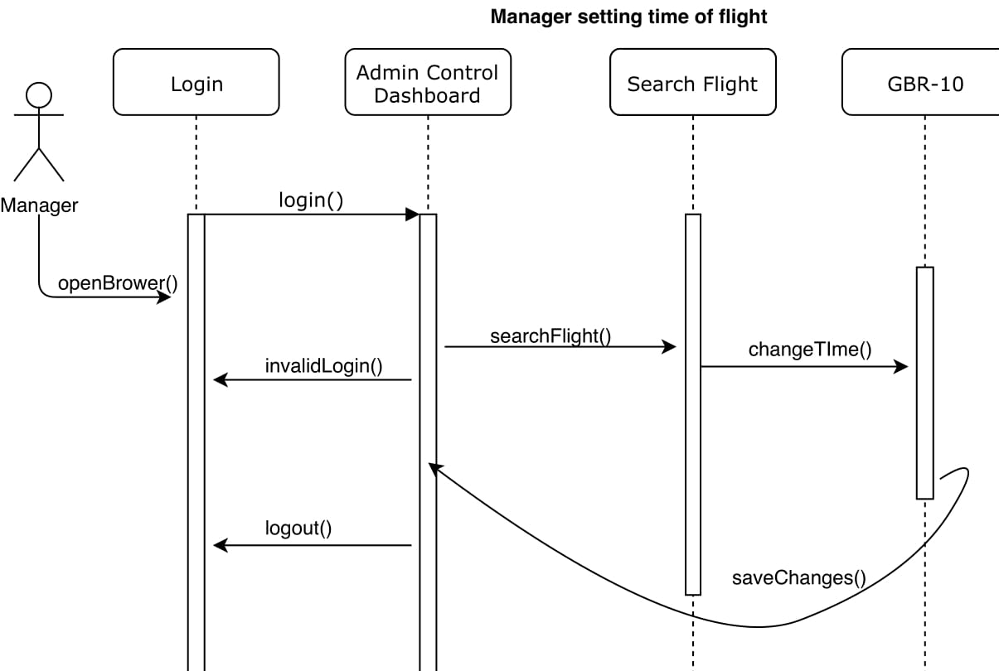
Manager Sequence Diagram (Manager - Luke Skywalker)
Setting time for flight
Dynamic Model
Result Page

Slide 12
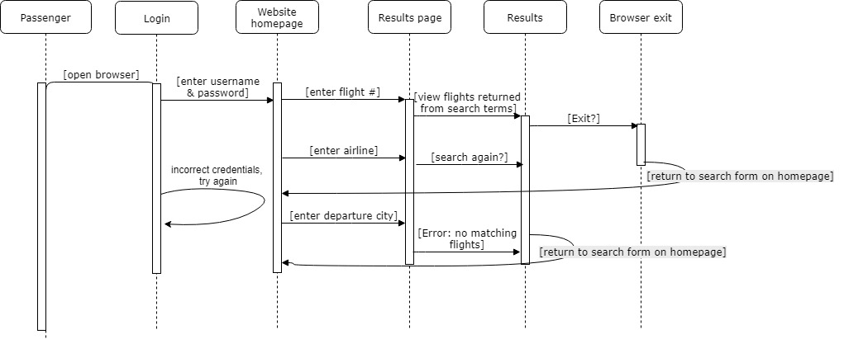
Passenger Sequence Diagram (Passenger – Han Solo)
Searching flight
Dynamic Model

Slide 13
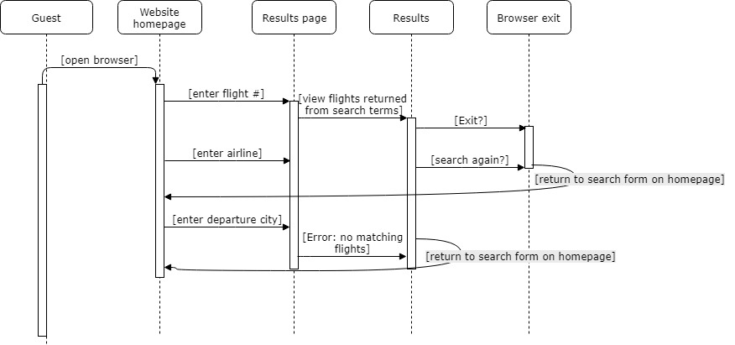
Guest Sequence Diagram (Guest - Rey)
Searching flight without logging into the portal
Dynamic Model

Slide 14
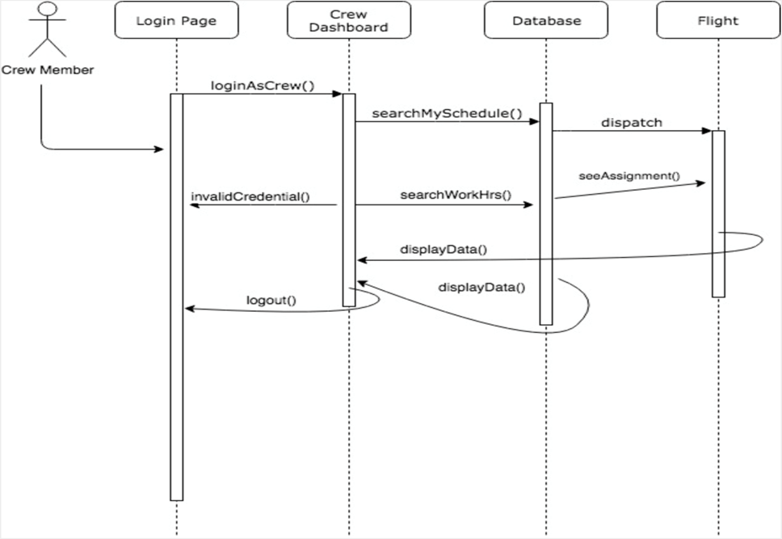
Crew Member Sequence Diagram (Crew - Poe Dameron(Pilot) )
Looking at assignment and working hrs.
Dynamic Model

Slide 15
Overview
Domain Project Description
Use Case Model
Use Case Diagram
Use Cases
Model
Class Diagram
Sequence Diagrams
Reflection

Slide 16
Reflection
What went well
Having a good vision of models helped clarify the scope of the project even more.
Beginning to think about how to test each of the sections to
determine what works and what does not. Is it a bug or a feature?

Slide 17
Reflection
Some challenges
Identifying the relationships between the user case was challenging.
Something to improve
We haven't yet included the relationship between the user case using include and extend. We are not sure if our system requires it. That is something we can think of in coming future.

Slide 18
Overview
Project Description
Use Case Model
Use Case Diagram
Use Cases
Domain Model
Class Diagram
Sequence Diagrams
Reflection

